Slide 1


Slide 2
Agenda
What is a SPA, and why React
Create a React app
JSX
Function Components - Props
Class Components - Props + State + Lifecycle

Slide 3
What is React
React is a JavaScript library for building user interfaces
Build by Facebook, starting from 2013
Uses components as UI building blocks
Unidirectional data flow - data is declared at the top, and when updated it changes flows to the bottom. Top to bottom data flow.

Slide 4
Why?
Multi page web apps
We can separate concerns in css and js, by splitting and importing different files, how it is done with HTML?
DRY - having the same code written once, and used in many places - components
Abstraction & Modularity

Slide 5
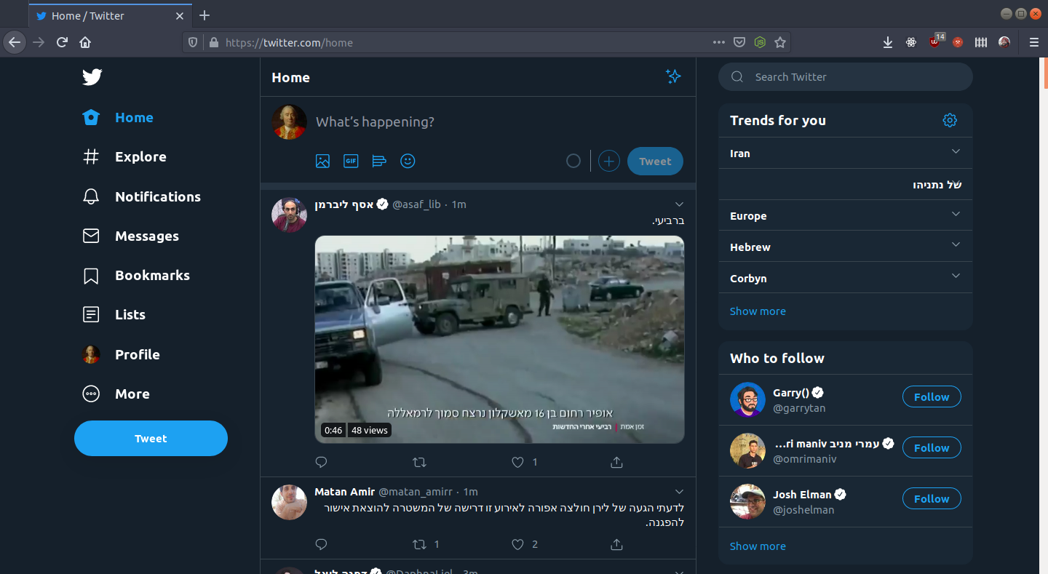
Thinking in components

Slide 6
Getting started
Install nodejs - nodejs.org (the LTS version)
Open terminal (mac/linux) or cmd/git bash (windows)
Type npx create-react-app my-app
Enter the new created folder with cd my-app
Open VSCode there with code . (or just do it through a new VSCode window)
Create react app

Slide 7
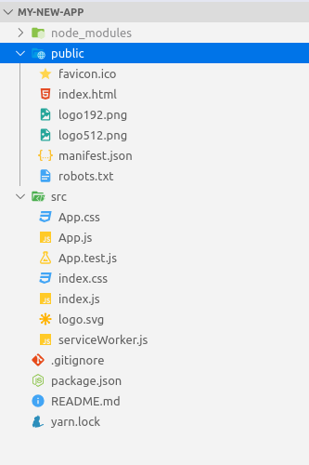
Folder structure

Slide 8
Folders and files
src - where your code and dynamic content is saved. This is where react will look for when building and compiling.
public - static assets (like static media files), that will be served in your server.
package.json - the metadata file for your JS project, where your dependencies (external libs) are declared.
node_modules - where your dependencies are saved.
.gitignore, yarn.lock, README.md - project meta files (google them)

Slide 9
JSX - HTML in JS
We can write HTML tags in JS
const element = <h1>Hello, world!</h1>;
For both HTML elements and custom react components
JS expressions can be added to the HTML inside curly braces
<span>4 + 5 = { 4 + 5 }</span>

Slide 10
JSX - HTML in JS
We can write HTML tags in JS
For regular HTML elements, and react components
JS expressions can be added to the HTML inside curly braces
Element attributes are all in camelCase.
e.g. onclick -> onClick
the class attribute is className (why - class is a reserved word in JS)

Slide 11
Components
DRY - Code modules for encapsulating view and logic.
Has input - props
Has output - events (also as props)
Simplest type of component - Function component

Slide 12
Functional component
A simple functional component:
import React from 'react';
function Welcome(props) {
return <h1>Hello, {props.name}</h1>;
}
//using the component
<Welcome name={"My Name"}></Welcome>

Slide 13
Functional component
Props can also contain other elements and components
function ComponentWithChildren(props) {
return (
<div>
{ props.children }
</div>
)
}
function MyOtherComponent(props) {
return (
<ComponentWithChildren>
<h3>I'm a child of ComponentWithChildren</h3>
</ComponentWithChildren>
)
}

Slide 14
Why do we need components
A react code without additional components (only the main app component)

Slide 15
import React from 'react';
import './App.css';
function App() {
return (
<div className="App">
<header className="App-header">
<ul className="users-list">
<li className="user-item">
<img className="user-image" src="https://randomuser.me/api/portraits/lego/1.jpg" alt="Patrick Nguyen" />
<span>Patrick Nguyen</span>
</li>
<li className="user-item">
<img className="user-image" src="https://randomuser.me/api/portraits/lego/4.jpg" alt="Evie-Mai Oconnor" />
<span>Evie-Mai Oconnor</span>
</li>
<li className="user-item">
<img className="user-image" src="https://randomuser.me/api/portraits/lego/8.jpg" alt="Ceara Gamble" />
<span>Ceara Gamble</span>
</li>
<li className="user-item">
<img className="user-image" src="https://randomuser.me/api/portraits/lego/2.jpg" alt="Anja Weston" />
<span>Anja Weston</span>
</li>
<li className="user-item">
<img className="user-image" src="https://randomuser.me/api/portraits/lego/3.jpg" alt="Azaan Conley" />
<span>Azaan Conley</span>
</li>
<li className="user-item">
<img className="user-image" src="https://randomuser.me/api/portraits/lego/5.jpg" alt="Brady Bell" />
<span>Brady Bell</span>
</li>
</ul>
</header>
</div>
);
}
export default App;

Slide 16
Why do we need components
We are repeating the same code in the list - not so DRY
Let’s export the code to a Functional Component, that has props as an input
Remember: React re-renders the component when it’s props change!
Props are read-only!

Slide 17
import React from 'react';
import './App.css';
function UserItem(props) {
const { name, imageUrl } = props;
return (
<li className="user-item">
<img className="user-image" src={imageUrl} alt={name} />
<span>{name}</span>
</li>
);
}
function App() {
return (
<div className="App">
<header className="App-header">
<ul className="users-list">
<UserItem name={"Patrick Nguyen"} imageUrl={"https://randomuser.me/api/portraits/lego/1.jpg"}/>
<UserItem name={"Evie-Mai Oconnor"} imageUrl={"https://randomuser.me/api/portraits/lego/4.jpg"}/>
<UserItem name={"Ceara Gamble"} imageUrl={"https://randomuser.me/api/portraits/lego/8.jpg"}/>
<UserItem name={"Anja Weston"} imageUrl={"https://randomuser.me/api/portraits/lego/2.jpg"}/>
<UserItem name={"Azaan Conley"} imageUrl={"https://randomuser.me/api/portraits/lego/3.jpg"}/>
<UserItem name={"Brady Bell"} imageUrl={"https://randomuser.me/api/portraits/lego/5.jpg"}/>
</ul>
</header>
</div>
);
}
export default App;

Slide 18
Why we need Class Components
Class components also have an internal state (in addition to props)
React re-renders the class component when either the props or state change.
When do we need class components: whenever we need to keep an internal state of the component.

Slide 19
Class Components - example
Form component - when we need to keep the form values before doing something with them
Props are read-only, so we can’t change them and keep internal data in them

Slide 20
Class Components - example
Form component - when we need to keep the form values before doing something with them
function MyFormComponent(props) {
const onUsernameChange = (event) => {
const value = event.target.value;
// can't assign the value to nowhere
// props.username = value -> invalid! props are readonly
}
const onSubmit = (event) => {
event.preventDefault();
//can't access the function internal state
console.log('Form submitted');
}
return (
<form onSubmit={onSubmit}>
<input name="username" type="text" onChange={onUsernameChange} />
<input type="submit" value="send"/>
</form>
);
}
A functional component won’t be helpful in this case - let’s convert it to a class component

Slide 21
Class Components - example
class MyFormComponent extends React.Component {
constructor(props) {
super(props);
this.state = {
username: ''
};
}
onUserNameChange(event) {
const value = event.target.value;
this.setState({ username: value });
}
onSubmit(event) {
event.preventDefault();
const { username } = this.state;
console.log(`The username is ${username}`);
}
render() {
return (
<form onSubmit={(event) => this.onSubmit(event)}>
<input name="username" type="text" onChange={(event) => this.onUserNameChange(event)} />
<input type="submit" value="send" />
</form>
);
}
}
Must be included in each constructor
Set the initial state in the component
Set the internal state of the component
The method where the view is rendered, called by react every time the props or state changes

Slide 22
Class Component
A simple class component:
class Welcome extends React.Component {
constructor(props) {
super(props);
this.state = {
myVar: 'value',
}
}
render() {
const { myVar } = this.state;
const { myPropVar } = this.props;
return <h1>Hello { myVar }, { myPropVar }</h1>
}
}

Slide 23
Class Components - notes
Always use this.setState(...) when wanting to change the state (do not reassign the state by doing this: this.state = …)
render is called each time new props come in the component (from the parent component), or whenever you call this.setState(...)

